Slide 1
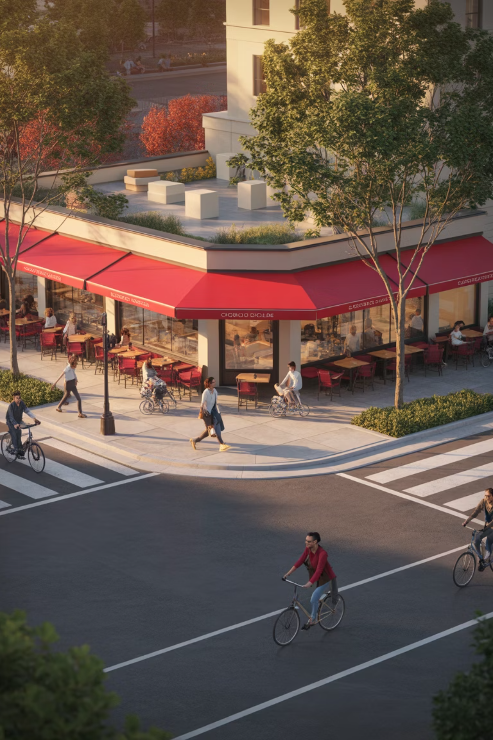
15-Minute City
A human-scale urban model where most daily needs—groceries, schools, healthcare, parks, and work—are reachable within a 15-minute walk or bike ride. This framework reimagines cities as collections of complete neighborhoods that prioritize proximity, safety, and choice over car dependency.

Slide 2
Agenda
01
02
03
Definition & Principles
Case Studies: Paris, Melbourne
Street Redesign Elements
Core concepts and foundational elements
Real-world implementation lessons
Complete streets infrastructure
04
05
06
Mixed-Use Zoning Toolkit
Mobility Modes
Equity & Accessibility
Regulatory frameworks that enable proximity
Walking, cycling, transit, and micromobility
Universal design and anti-displacement
07
08
09
Misconceptions & Myth-busting
Cost/Benefit Analysis
Implementation Roadmap & Metrics
Addressing common concerns
Economic case for transformation
Phased approach and success measures

Slide 3
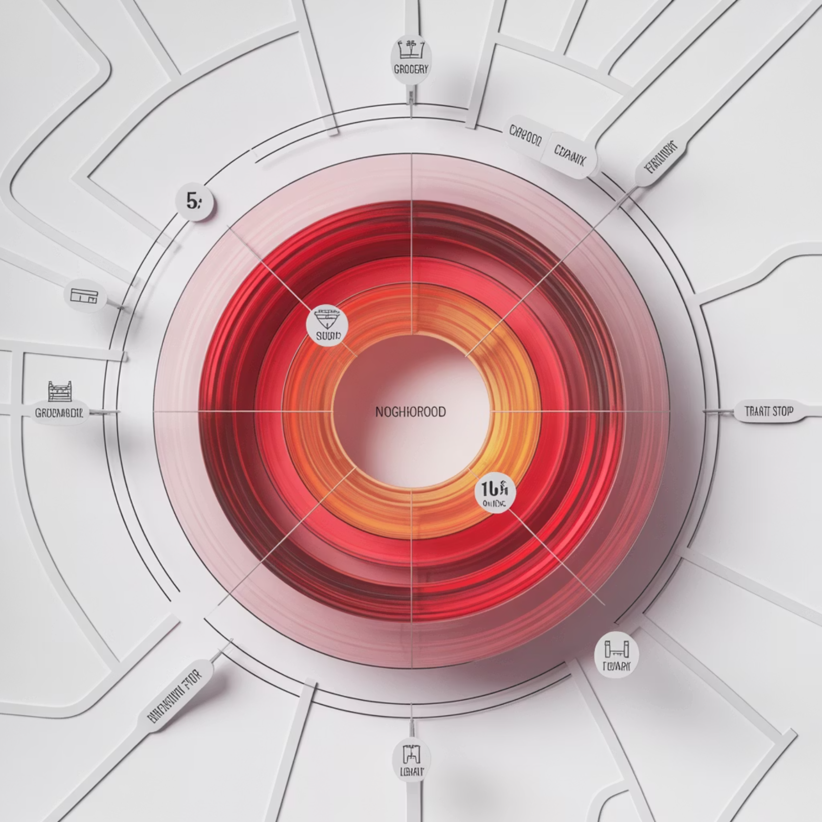
What Is a 15-Minute City?
Definition
A planning framework that clusters daily needs—home, work, learning, care, groceries, parks—within a 15-minute walk or bike ride, prioritizing proximity, safety, and meaningful choice in how people move through their neighborhoods.
Core Principles
Proximity: short trips to essentials reduce time lost to commuting
Diversity: mixed uses and housing types create vibrancy
Density done well: enough people to support local services
Complete networks: safe, continuous walking, cycling, and transit
Human-scaled streets: slower speeds and greener public realm
Digital/physical integration: delivery lockers, telehealth, coworking
Participatory governance: neighborhood co-design processes
Equity: invest first where access gaps are largest
Climate resilience: shade, stormwater management, low-carbon mobility
Essential Service Basket
A complete neighborhood provides convenient access to:
Groceries and pharmacy
Primary school and childcare
Clinic or health services
Pocket park or linear park
Transit stop with frequent service
Coworking space or library
Everyday retail and cafés

Slide 4


Case Studies: Paris & Melbourne
Two cities pioneering proximity-based planning at scale, each adapted to their unique urban context and governance structures.
Paris
Melbourne
A citywide proximity strategy that includes school street closures, bike network expansion, local service clustering, and a 30 km/h default speed limit on most streets. Paris has moved from pilot to permanent infrastructure at remarkable speed.
"20-minute neighborhoods" within Plan Melbourne emphasize walkable catchments to daily needs, with a strong focus on activity centers as anchors for services and transit.
Key Highlights
Key Highlights
"Rues aux écoles" (car-lite school streets) protect children and improve air quality
Activity centers as anchors ensure critical mass of services
Neighborhood-scale amenities and micro-hubs bring services closer
Green links and laneways network create pleasant walking routes
Protected cycleways connecting arrondissements create a citywide network
Health and aging-in-place focus ensures long-term livability
Learning: Pair quick-build trials with permanent upgrades; communicate benefits at the block level to build trust and momentum.
Learning: Use activity center hierarchy to stage investment strategically; align planning goals with measurable health outcomes.

Slide 5
Street Redesign Elements
Building Complete Streets for All Users
Transforming car-dominated corridors into complete streets requires reallocating space to prioritize safety, comfort, and multimodal access. A typical 24-meter right-of-way can accommodate all users when designed intentionally.
Pedestrian Infrastructure
Protected Bike Facilities
Continuous sidewalks (minimum 3.0m) with compliant curb ramps, tactile paving at crossings, and furnishing zones for street trees, seating, and lighting.
Physically separated bike lanes (1.8m width + 0.5m buffer) with intersection protection, clear sightlines, and secure parking at destinations.
Transit Priority
Traffic Calming
Dedicated bus lanes (3.0m), queue jump signals, all-door boarding, and real-time arrival information to improve speed and reliability.
Design for 30 km/h speeds through raised crossings, curb extensions, chicanes, and narrowed travel lanes (2.7m maximum).
Curb Management
Green Infrastructure
Time-of-day loading bays, micromobility parking corrals, parklets, and flex zones that adapt to neighborhood needs throughout the day.
Continuous tree canopy for shade, bioswales for stormwater management, permeable surfaces, and nature-based cooling strategies.

Slide 6


Mixed-Use Zoning Toolkit
Traditional single-use zoning creates the very separation that 15-minute cities aim to overcome. A modern regulatory toolkit enables the mix of uses, housing types, and scales necessary for complete neighborhoods.
Form-Based Codes
Missing-Middle Housing
Regulate building form, frontage character, and public realm interface rather than separating uses. Ensure active ground floors and human-scaled street walls that create pedestrian vitality.
Legalize triplexes, fourplexes, courtyard apartments, and accessory dwelling units (ADUs) to diversify housing options and increase choices near services and transit.
Adaptive Reuse
Parking Reform
Streamline conversions of obsolete offices, retail big-boxes, and underutilized structures into housing, schools, clinics, and community spaces.
Eliminate minimums that inflate costs and sprawl. Implement maximums, shared parking agreements, cash-out programs, and curb pricing to right-size auto infrastructure.
Inclusionary Zoning
Corner Commercial Allowance
Reserve a percentage of units in new developments as affordable near transit and amenities, preventing displacement and ensuring economic integration.
Embed small-format retail, childcare, and cafés directly into residential blocks, creating hyper-local destinations that don't require driving.
Implementation Note: Pair zoning reform with technical assistance grants and low-interest loans for small developers and main-street businesses to accelerate adoption.

Slide 7
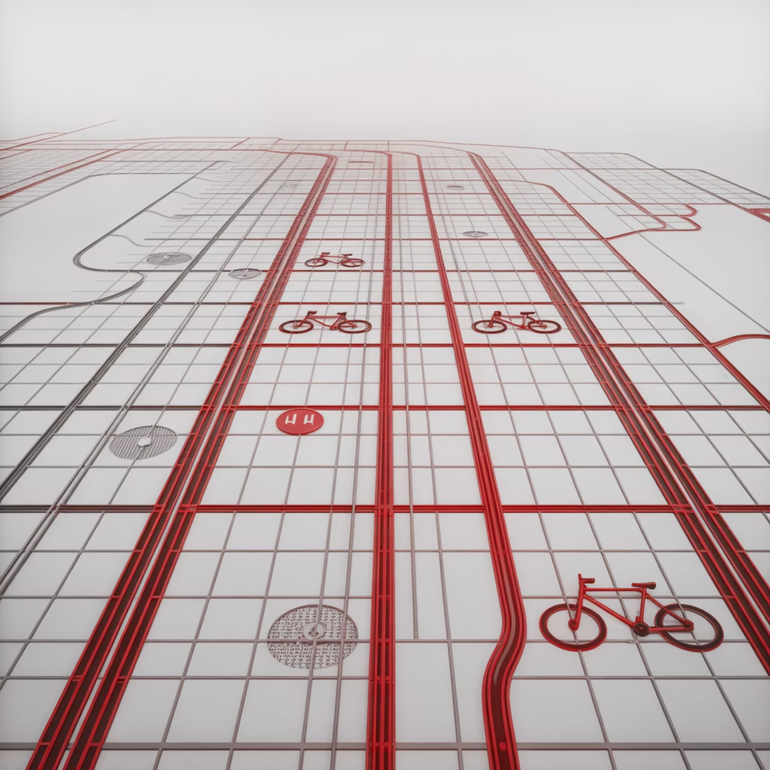
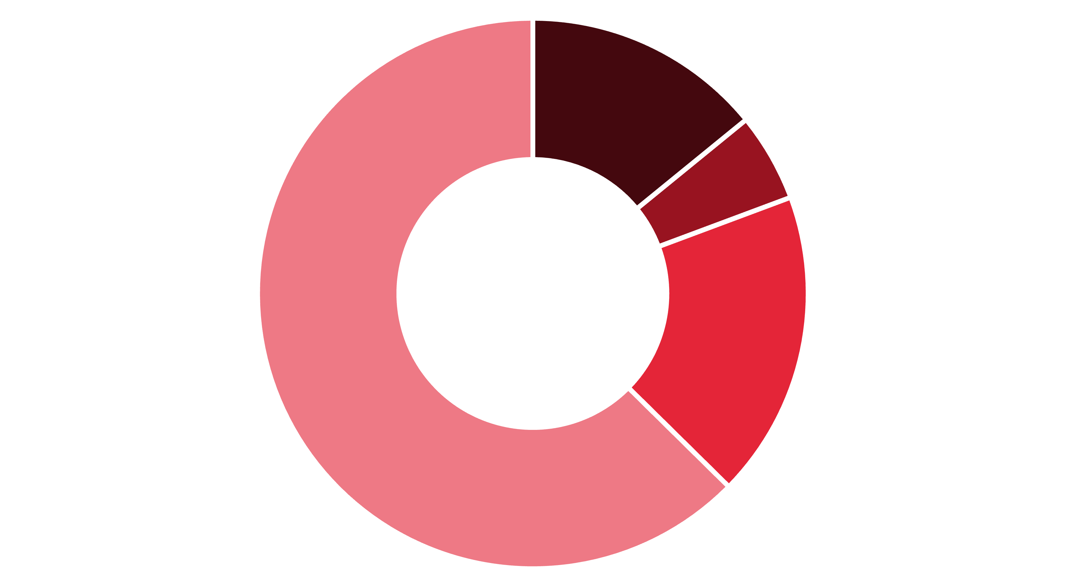
Mobility Modes & Networks
Complete neighborhoods require complete mobility networks that offer safe, convenient, and affordable options for every trip type and every resident.
Mode Options
Walking: universal baseline requiring continuous shade trees and safe crossings every 80–100 meters
Cycling & e-bikes: protected network with secure parking at shops, schools, and transit stops
Transit: frequent local buses or trams with timed transfers and integrated fare payment
Micromobility: shared scooters and bikes with designated corrals and dockless geofencing
Deliveries: cargo bikes and off-peak loading windows reduce conflicts with other users
Car share: right-sized auto access without the cost and space burden of ownership
A successful 15-minute city provides a hierarchy of mobility networks that work together: primary cycling corridors at 400-meter spacing, local greenway connections, high-frequency transit on main streets, and pedestrian priority zones around schools and parks.
Walk
Bike
Transit
Car
This mode shift is enabled by complete networks, improved service quality, and pricing reform that reflects the true cost of driving.

Slide 8
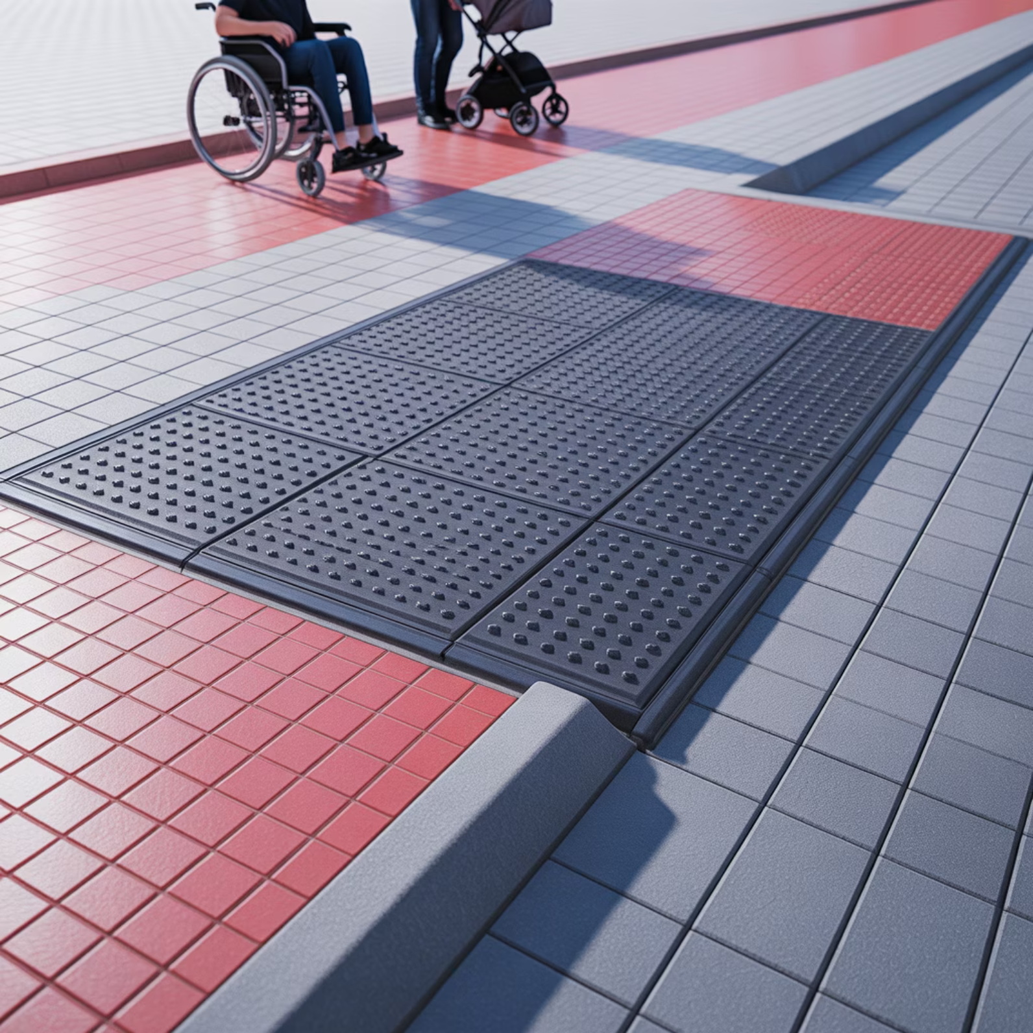
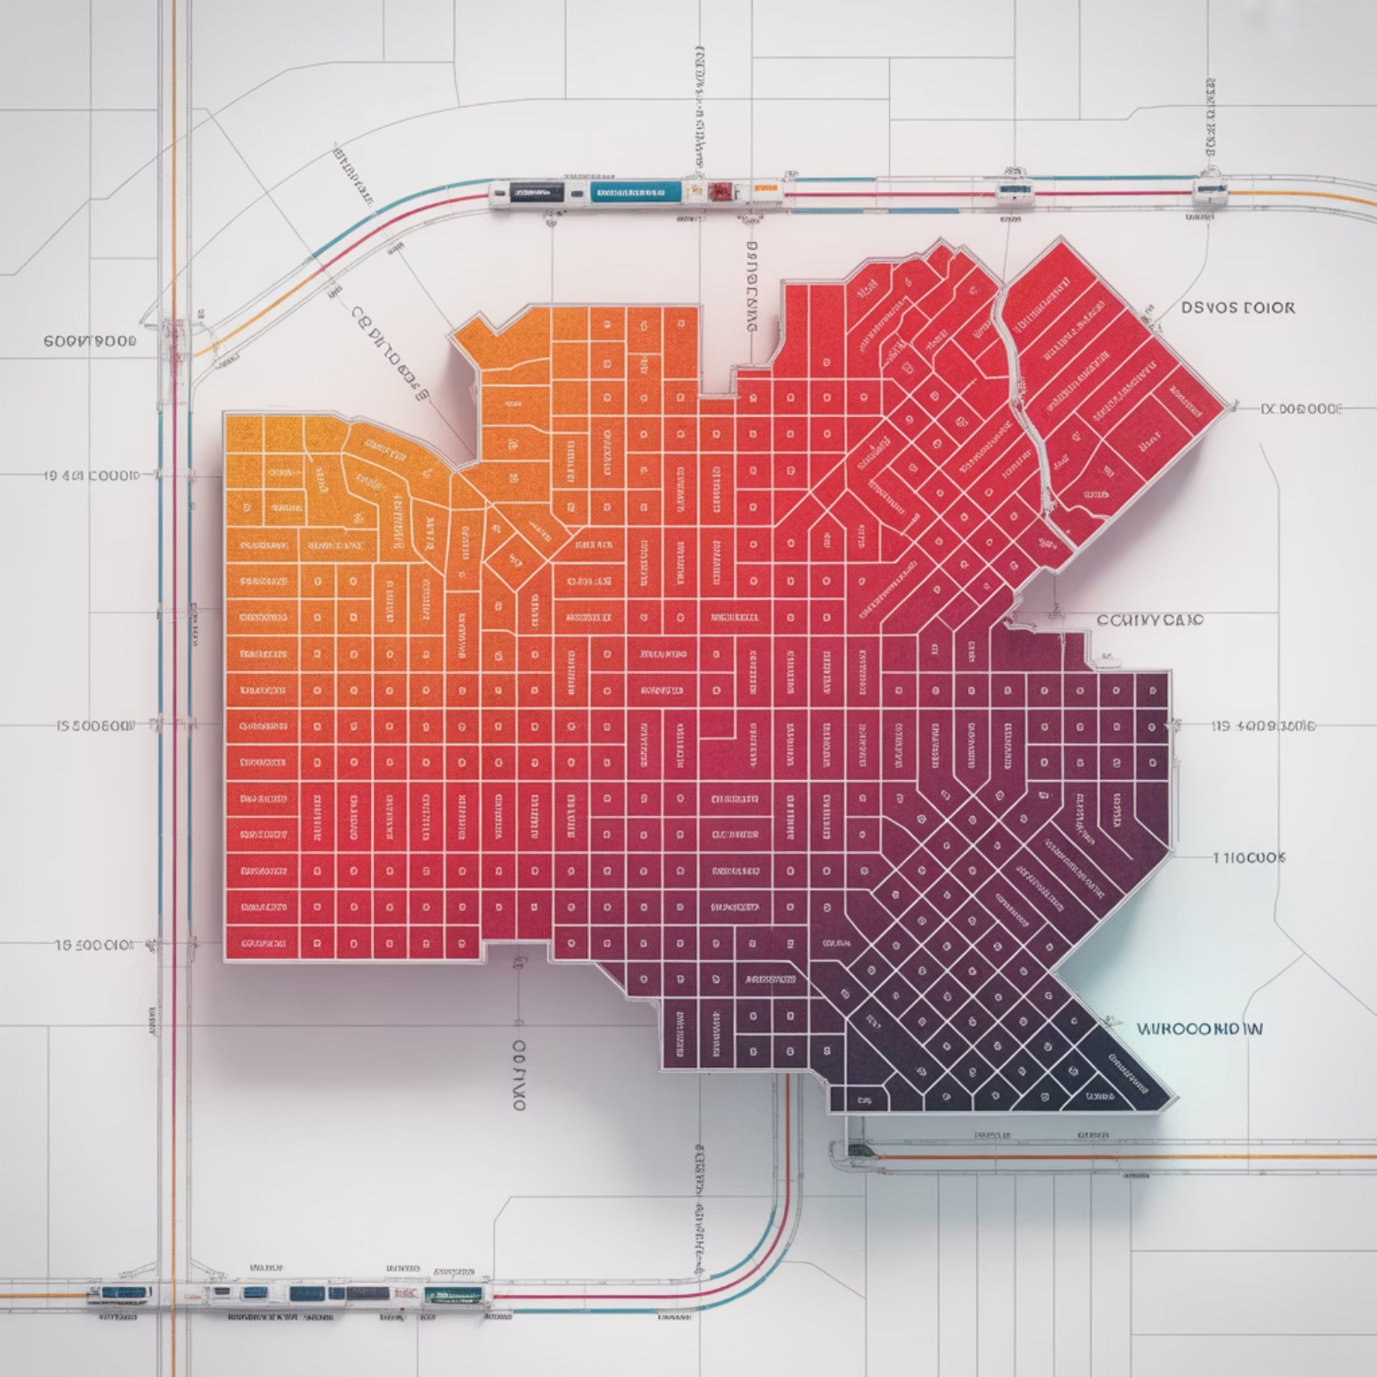
Equity & Accessibility
Ensuring Benefits Reach Those Who Need Them Most
Equity Levers
Without intentional intervention, neighborhood improvements can accelerate displacement. These tools center equity in implementation:
Invest first in underserved neighborhoods experiencing access deserts and disinvestment
Zero-fare or discounted transit for low-income riders, youth, and seniors removes financial barriers
Anti-displacement measures: community land trusts, right-to-return policies, rent stabilization
Safe routes to schools and late-night worker corridors protect vulnerable populations
Community co-design: multilingual workshops with stipends, childcare, and accessible venues
Universal Design Standards
Continuous curb ramps and tactile guidance systems at all crossings
Audible signals; benches every 100–150 meters; shade and lighting
Step-free building entries; wider doorways; at-grade transit boarding
Key Performance Indicators
Percentage of low-income residents within 15-minute walk of grocery and clinic
Pedestrian and cyclist crash rate per 100,000 population
Transit travel time to jobs (50th and 90th percentile)

Slide 9






Misconceptions & Myth-Busting
As 15-minute city concepts gain traction, misinformation and legitimate concerns deserve clear, factual responses.
Myth: 15-minute cities "restrict movement"
Fact: They expand choices by bringing more destinations nearby. Regional and intercity travel remains unchanged—in fact, better local transit connections often improve regional mobility.
Myth: It's anti-car
Fact: It's pro-option. People who need or choose to drive benefit from safer streets, less congestion from short trips, and smarter car-sharing or on-demand access.
Myth: Only works in dense European cores
Fact: The framework adapts to context. Retrofit underused arterials, re-center town centers, add mixed uses in suburban corridors, and cluster services around transit nodes.
Myth: Hurts local business
Fact: Foot traffic and dwell time typically increase on people-first streets. Customers who walk or bike often spend more per month than drivers making quick stops.
Myth: Too expensive for cities to afford
Fact: Low-cost pilots using paint, posts, and planters prove concepts quickly. Curb pricing and parking reform generate revenue to fund phased, high-return infrastructure upgrades.
Myth: One-size-fits-all mandate
Fact: Each neighborhood is co-designed with residents. Service baskets and infrastructure priorities reflect local needs, culture, and existing assets.

Slide 10
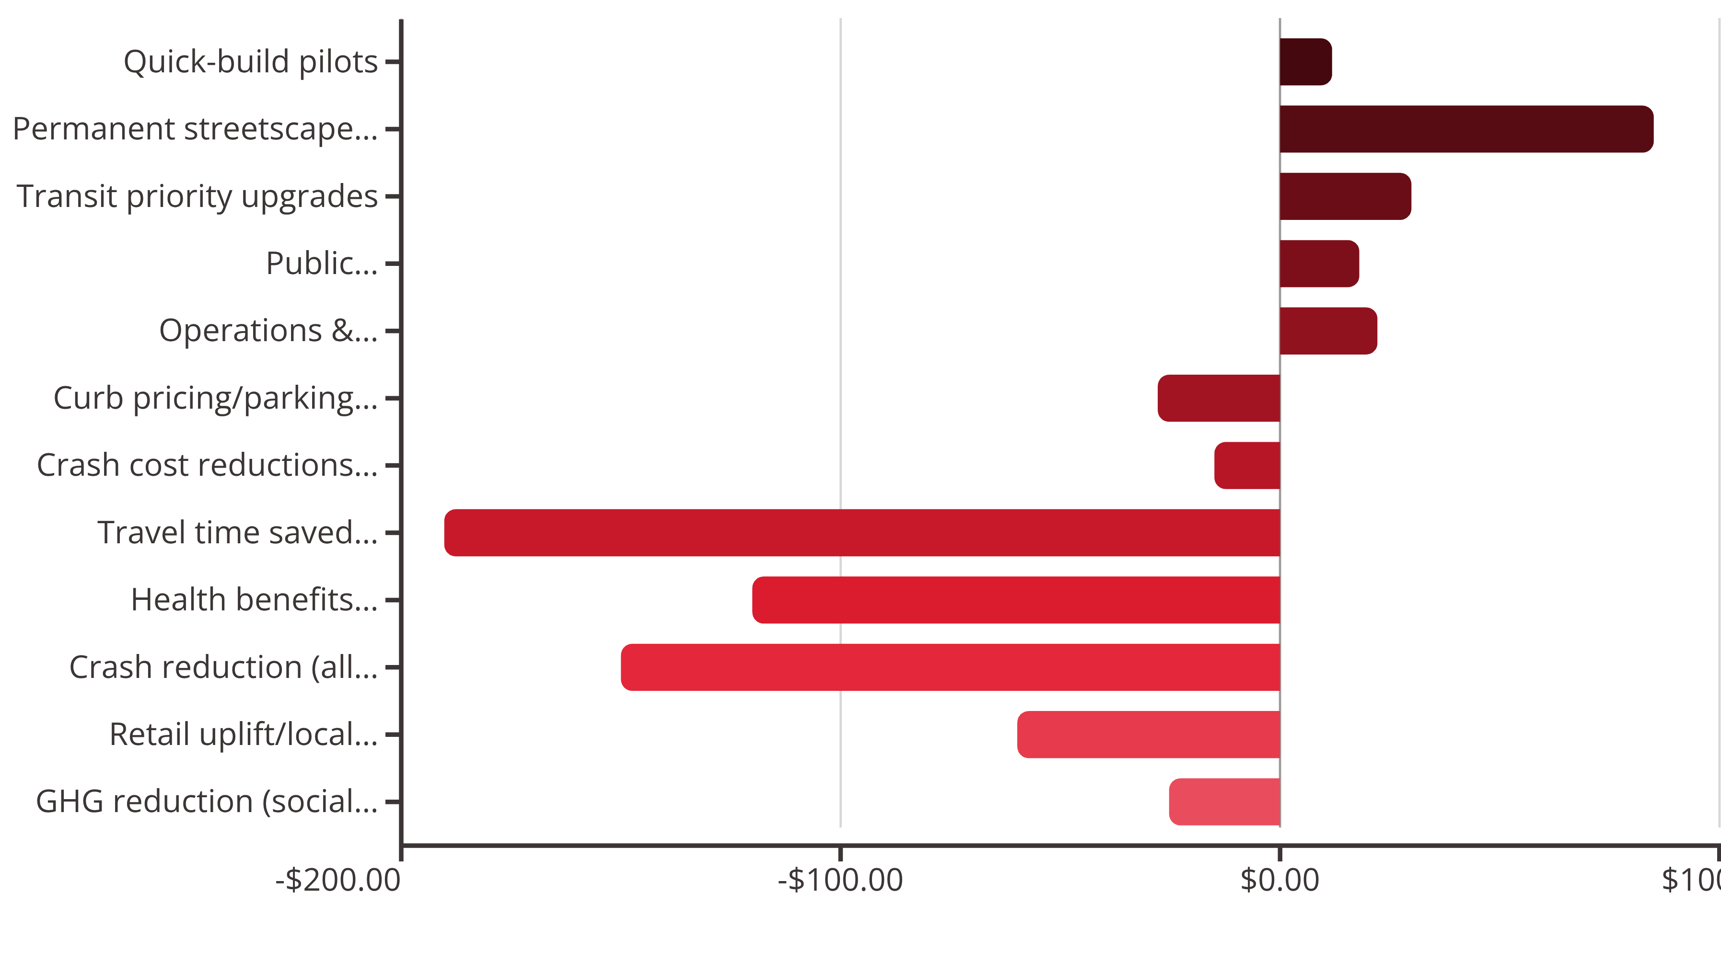
Costs and Benefits
Illustrative 10-Year Net Present Value per 100,000 Residents (3% Discount Rate)
Investment in 15-minute infrastructure delivers quantifiable returns across health, safety, economic vitality, and environmental outcomes. This waterfall illustrates costs, offsets, and benefits over a decade.
Net NPV: approximately -$411 million in benefits after accounting for all costs and offsets. Monetization follows standard cost-benefit analysis methods (e.g., USDOT guidance). Tailor assumptions to local wage rates, crash data, and health baselines.

Slide 11
Implementation Roadmap & Metrics Dashboard
0–6 Months: Pilot Launch
18–36 Months: Scale & Institutionalize
Choose 2–3 pilot neighborhoods using equity criteria and community readiness
Scale program to additional districts; integrate health and economic KPIs
Quick-build interventions: school streets, pop-up bikeways, curb management zones
Institutionalize curb pricing; fund ongoing maintenance and main-street grants
Launch co-design workshops; publish access baseline and 2030 targets
Annual public report with isochrone maps, crash trends, and health outcomes
1
2
3
6–18 Months: Permanent Upgrades
Make successful pilots permanent with planters, shade trees, and drainage
Zoning updates: missing-middle housing, corner retail, parking reform adopted
Transit improvements: signal priority and bus lanes on key corridors
Key Performance Indicators
Track progress across five workstreams: Streets & Safety, Land Use & Housing, Transit & Operations, Equity & Community, and Data & Evaluation.
70%
50%
35%
85%
Access Target
Injury Reduction
Mode Shift
Retail Occupancy
Residents within 15-min walk to 5+ services by 2030
Serious pedestrian & cyclist injuries per 100k (target decline)
Combined walk/bike/transit share by 2030
Occupancy rate on pilot corridors after improvements
Data Sources: Transit AVL/GTFS-RT, crash database, privacy-preserving mobile/origin-destination data, business registry, and GIS/parcel datasets. Publish quarterly scorecards and hold annual community forums to review progress and adjust priorities.

